Slide 1
Sound synthesis and manipulation
COMP.SGN.120
Introduction to Audio processing
Lecture 7
Notes:
Audio representations for sound synthesis and manipulation

Slide 2
Sound synthesis and its uses
Sound synthesis
The goal is to produce sounds that are musically interesting and (if required) resemble a real instrument.
Sounds have to be produced in real time.
Intuitive control of the synthesized sound is important: interaction of the player makes the sound lively.
Audio effects include for example
Dynamic level control (lecture 6)
Equalization (lecture 6)
Time stretching and pitch shifting
Adding reverberation (in its simplest form, simply filtering the ”dry” sound with the impulse response of the target reverberant room)
Effects applied on musical sounds: flanger, chorus, phaser, wah-wah

Slide 3
Synthesis methods
Sampling: each note of an instrument is recorded and stored in the memory.
Additive synthesis: each harmonic of a complex tone is synthesized separately and added together.
Subtractive synthesis: the spectrum of a rich sound is modified by filters.
Non-linear synthesis: input-output relationship that produces new frequency components, meaningful in musical sound synthesis.
FM synthesis

Slide 4
Sampling synthesis
wavetable

Slide 5
Sampling synthesis
Recordings of relatively short sounds are played back
Samplers: digital sampling instruments: perform pitch shifting, looping, other modifications to the original signal
Very widely-used synthesis method
Memory requirements are the challenge of this approach
It is not economical to store all possible sounds from all instruments
The art of sampling synthesis is to minimize the memory consumption while maximizing the sound quality
Basic idea: to model sounds with less data

Slide 6
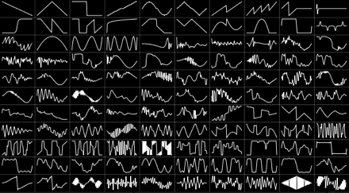
Wavetable synthesis
Seed waveforms are sampled sounds or instruments instead of fundamental waveforms such as sine and saw waves used in other types of synthesis.
Advantage: processing power requirements are much lower because most of the nuances of the sound models are contained in the prerecorded samples rather than calculated in real time.
Computer memory was expensive and samples had to be as short and as few as possible. This was achieved by looping a part of the sample (often a single wave)

Slide 7
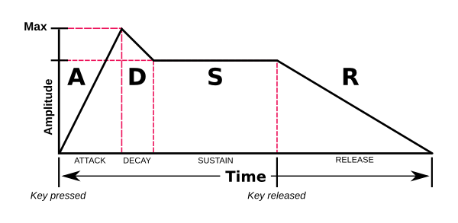
Looping
For most musical instruments, the steady-state (= sustain) part is nearly periodic
can take a short sample and play that in a loop buffer (Right figure)
The short beginning transient of a sound can be modeled separately
Looping part should be long enough to make it sound natural
Short loop sound clearly periodic
Even a very long loop repeated enough times reveals its periodicity
Temporal model of a note: Attack, Decay, Sustain, Release (ADSR)
Loop extracted from the sustain part (between looping points)
Enveloping: change perception of a sample by modifying ADSR curve to speed-up decay, shorten the attack time

Slide 8
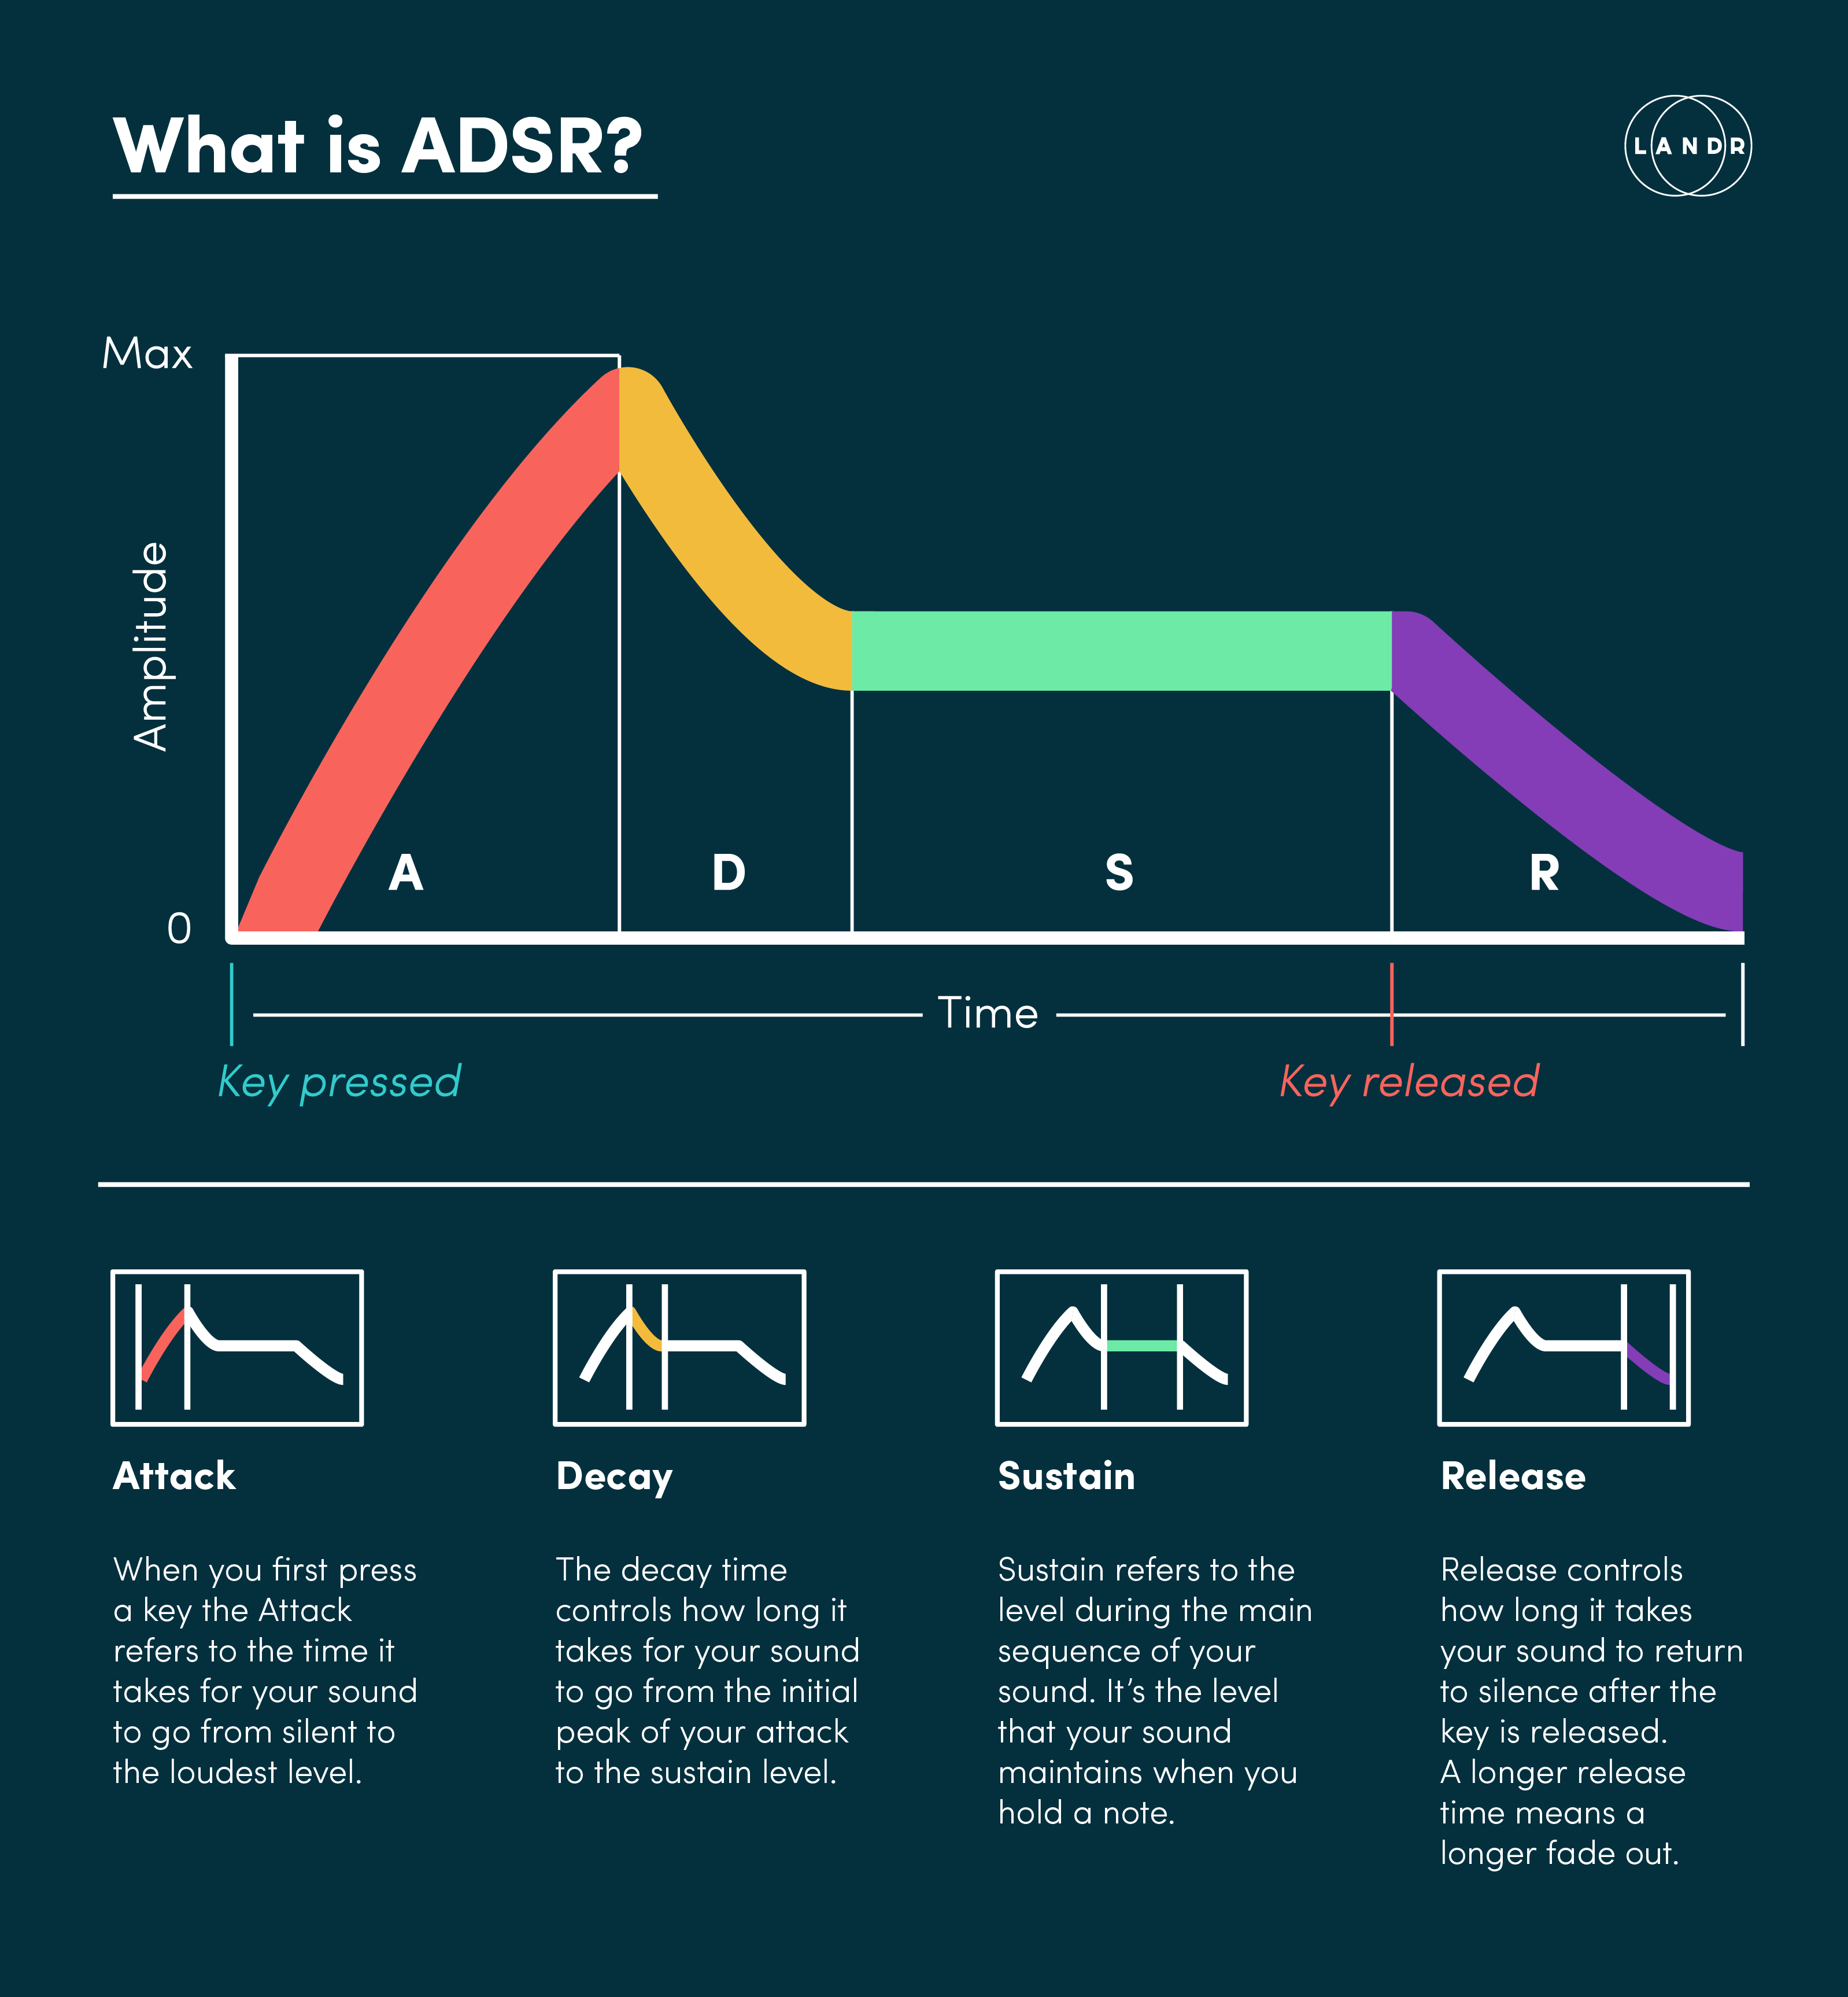

Slide 9
Multiple wavetable synthesis
Several buffers (wavetables) are played back simultaneously. A wave table: array in memory where a fragment of a waveform is stored.
Wavetable cross-fading
Store samples of the sound at several temporal positions
Cross-fade smoothly from one loop buffer to the next
Windowing can be applied, make the windows overlap + sum to 1
Wavetable stacking
The desired waveform is constructed by forming a weighted sum of several elementary waveforms that are played simultaneously (additive synthesis!)
Challenge: find a set of elementary waveforms (and amplitude envelopes) to represent various natural sounds

Slide 10
Additive

Slide 11
Additive synthesis
Idea:
Any (almost) periodic sound can be represented as a sum of sinusoids.
Each sinusoid’s frequency is a nearly multiple of the fundamental frequency
This method involves building sounds using multiple sine waves.
However, it is a cumbersome method and is not commonly used

Slide 12
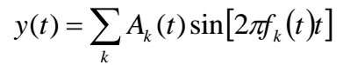
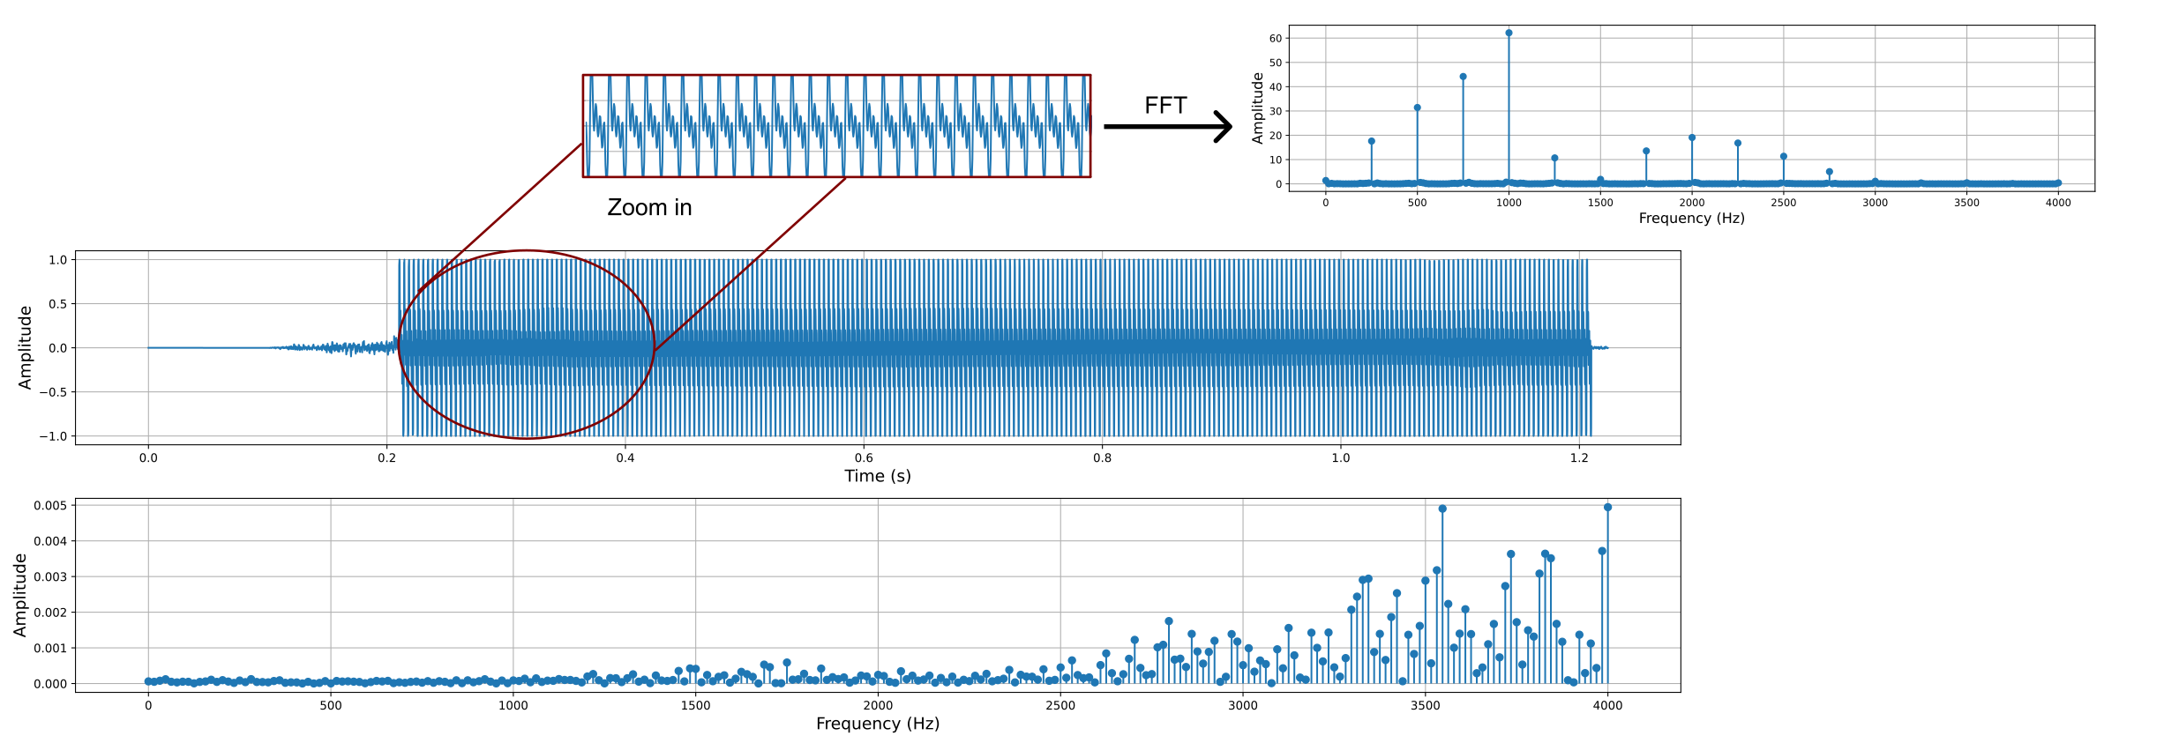

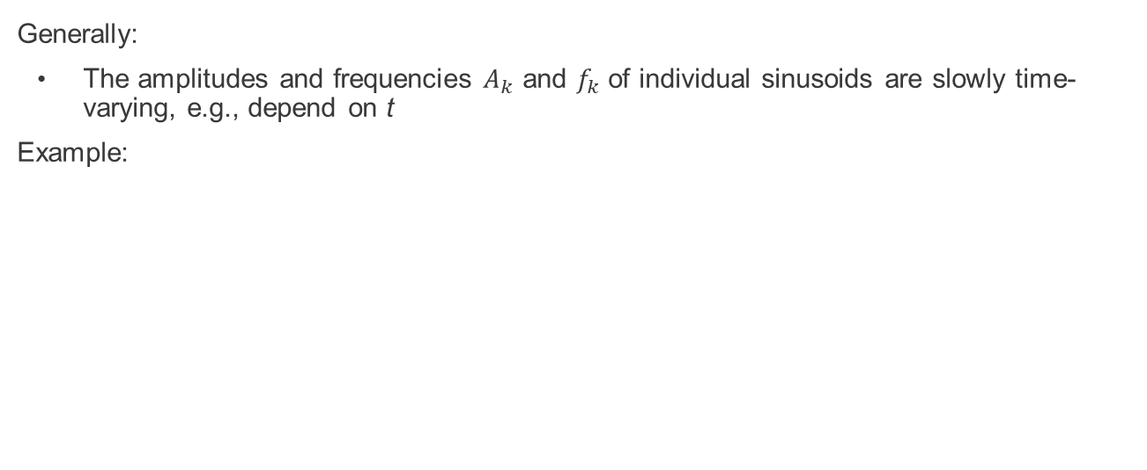
Additive synthesis
Generally:
The amplitudes and frequencies $A_{k}$ and $f_{k}$ of individual sinusoids are slowly time-varying, e.g., depend on t
Example:

Slide 13
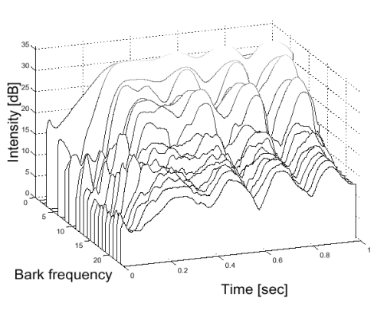
Additive synthesis
In principle enables very high quality
Drawbacks:
Requires a lot of data (time-varying parameters) for each note of each instrument
Large number of oscillators
Figure: temporal evolution of the harmonic frequencies of a flute sound

Slide 14
Subtractive synthesis

Slide 15
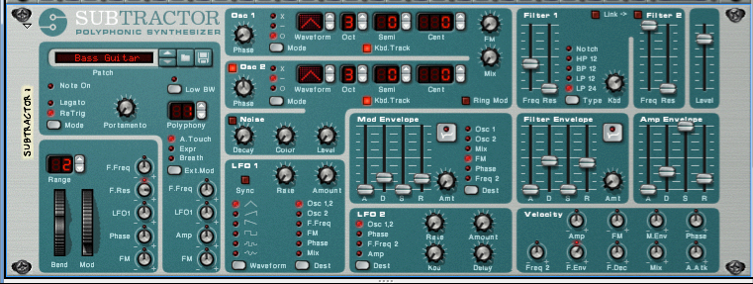
Subtractive synthesis
Idea:
The resulting sound is hiding somewhere in all the harmonics.
Procedure:
Subtract the unwanted harmonics and expose the properties of the sound.
The subtraction is done using a filter.
Further shaping of the sound is accomplished by modifying the filter parameters over time using envelopes or low frequency oscillators.

Slide 16
Non-linear synthesis

Slide 17
Modulation
Altering of the frequency, phase or amplitude component of an oscillator.
Carrier: oscillator that is being altered.
Modulator: oscillator that changes the carrier.
Modulator signal: is the input signal
Example:
The effect of vibrato is achieved by modulation of frequency.
The effect of tremolo is achieved by modulation of amplitude.

Slide 18
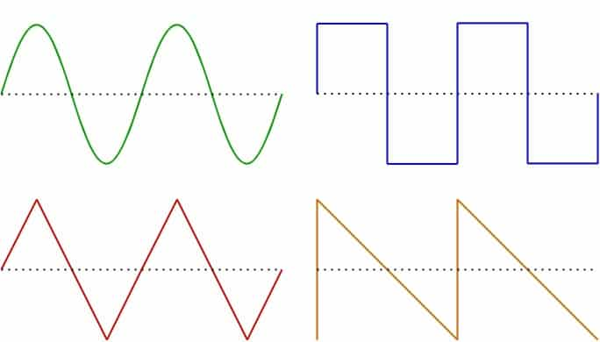
Oscillator
It is a periodic, oscillating signal that moves between a minimum and maximum value.
Oscillators often have a sine or square waveform but can have any repeating waveform.
Oscillators will also have a fundamental frequency and, potentially, a harmonic profile.

Slide 19
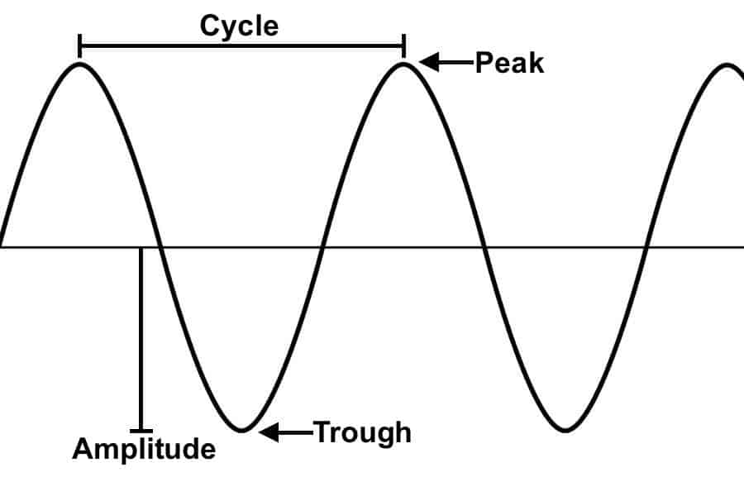
Oscillator
It is defined by its amplitude and its frequency.
It can modulate the following sound parameters:
Amplitude of the input signal
Delay time of a delay circuit
Corner frequency of cascading all-pass filters
Pan position of the signal

Slide 20
Low-Frequency Oscillator
LFO

Slide 21
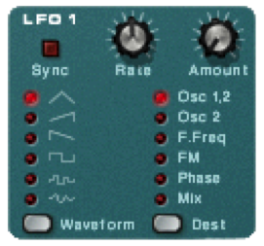
LFO
It is not part of the audio path of the synthesizer.
It is not possible to hear the frequency generated by the LFO.
It oscillates at frequencies well below the range of human hearing, anywhere from 10 Hz down to a fraction of a Hertz.
LFO’s are used like envelopes to modulate parameters of the synthesizer over time.
LFOs are used in tremolo, vibrato, chorus, flanger, phaser and auto-pan modulation effects.

Slide 22
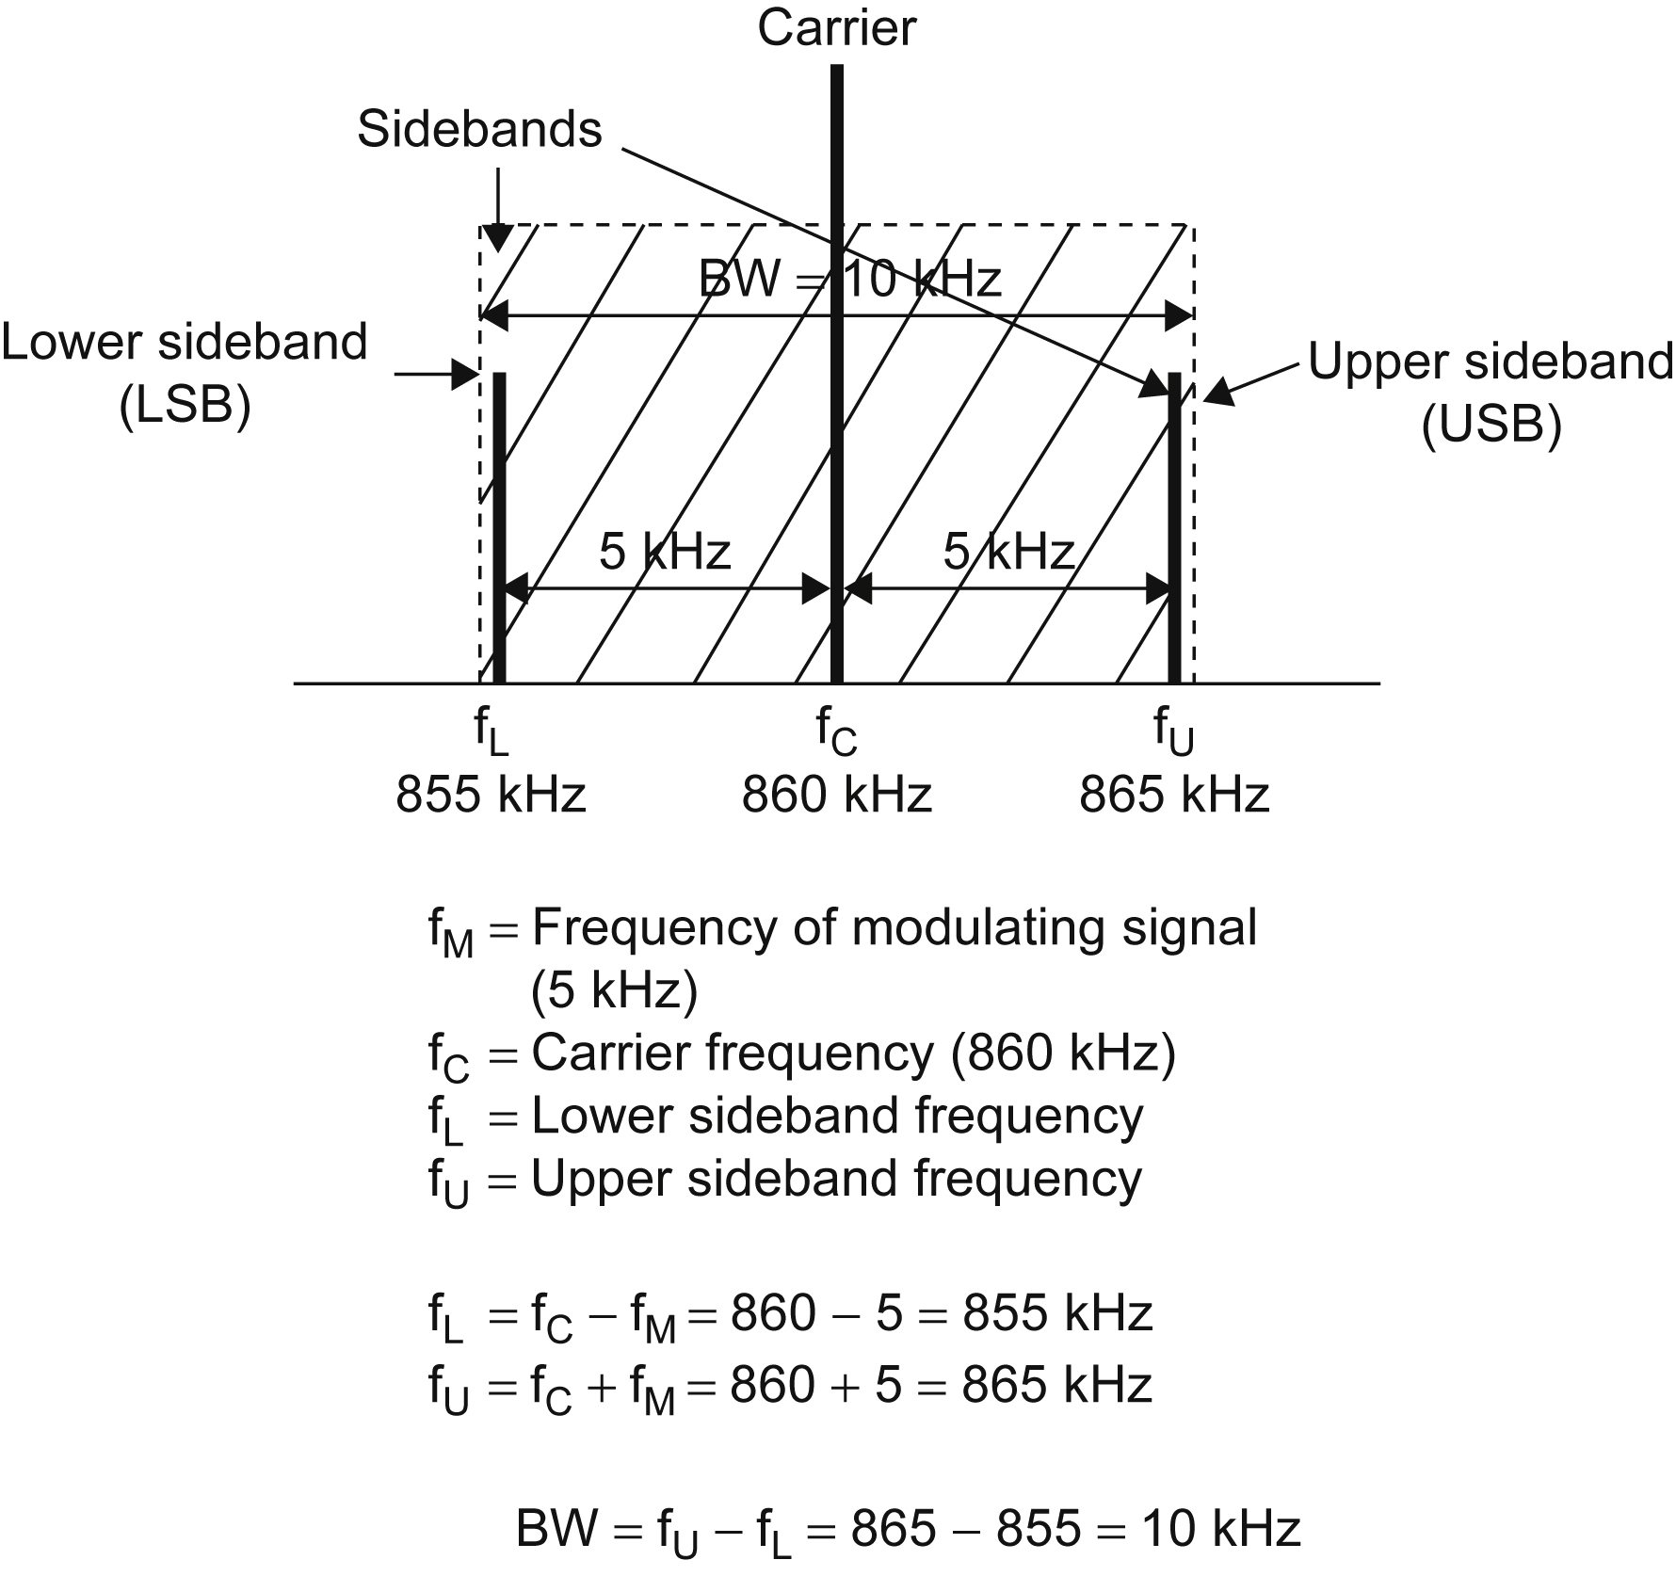
Bandwidth
Range of frequencies over which a radio signal operates.
This is also referred to as a radio channel

Slide 23
Modulate not mix
One simple waveform is used to modulate another with the result of being used to modulate another simple waveform etc.

Slide 24
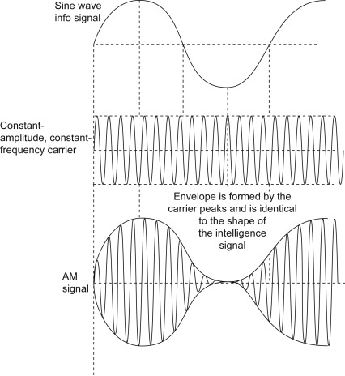
Amplitude modulation
Widely used in radio.
Problem:
to send an acoustic signal ( “message”), over the airwaves using a reasonably sized antenna to radiate it.
The size of the antenna depends inversely on the highest frequency present in the message,
voice signal: range of 100 Hz to about 5 kHz .
music signal: up to about 22 kHz.
The transmission of such signals with a practical antenna is impossible.
Solution:
Amplitude modulation
Notes:
When two signals are multiplied together, the amplitude of one signal modulates the amplitude of the other signal.

Slide 25
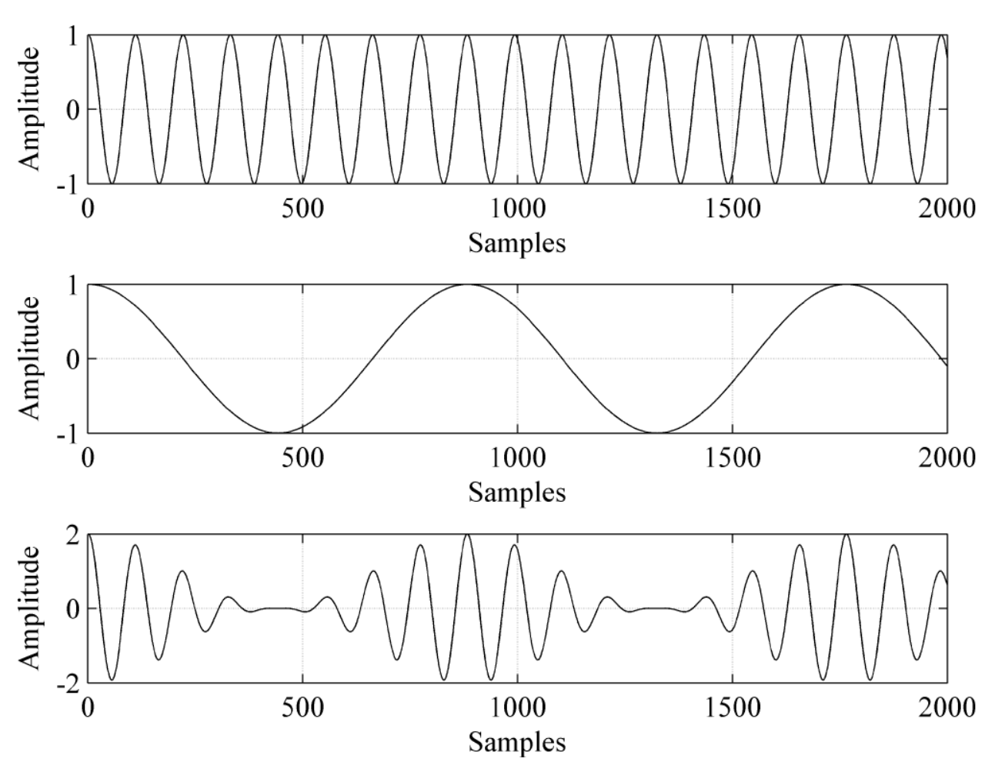
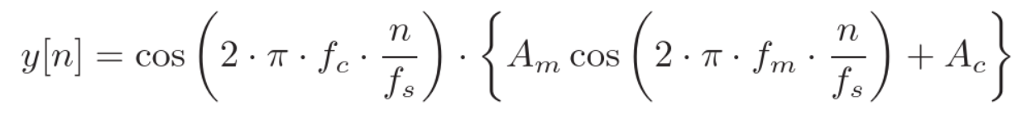
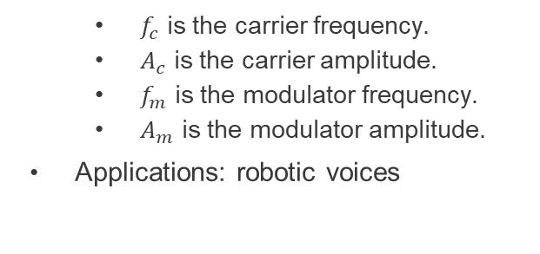
Amplitude modulation synthesis
$f_{c}$ is the carrier frequency.
$A_{c}$ is the carrier amplitude.
$f_{m}$ is the modulator frequency.
$A_{m}$ is the modulator amplitude.
Applications: robotic voices

Slide 26
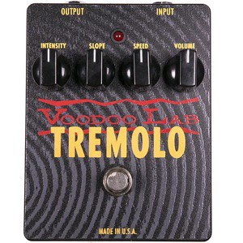
Amplitude modulation synthesis
Type of Amplitude modulation:
Tremolo, which is defined by a fast variation in amplitude.
The amplitude of the input signal is modulated via an LFO.
The LFO usually have a frequency between 2 and 12 Hz and is often a sine wave but can also be other waveforms as well, including triangle and square.

Slide 27
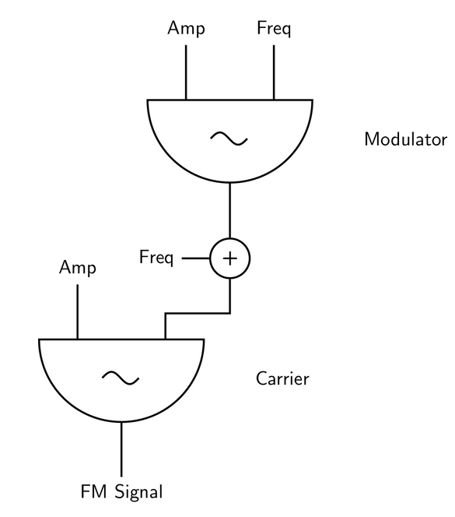
Frequency Modulation
It has been used in telecommunications, for example in broadcast radio, already for more than half a century.
Idea:
The frequency of a waveform (carrier) is changed by modulating its frequency with a modulator.
In late 1960s, John Chowning proposed to apply FM-synthesis for sound production
complex spectra can be synthesized with only a few voltage controlled oscillators
In 1983 Yamaha released its DX7 synthesizer
Great commercial success: an instrument that had high sound quality and price that could be afforded by the consumers

Slide 28
Frequency Modulation
In 1974:
Digital FM synthesis (implemented as phase modulation, mathematically equivalent) was the basis of several musical instruments.
FM synthesis stayed as the dominant synthesis method for years
Implementing FM-synthesis in its simplest form requires only 10 lines of (Matlab) code and a few parameter values
Until mid 90s
Yamaha dx7 - Notoriously difficult to program, patented and monopolized the market for FM technology.

Slide 29
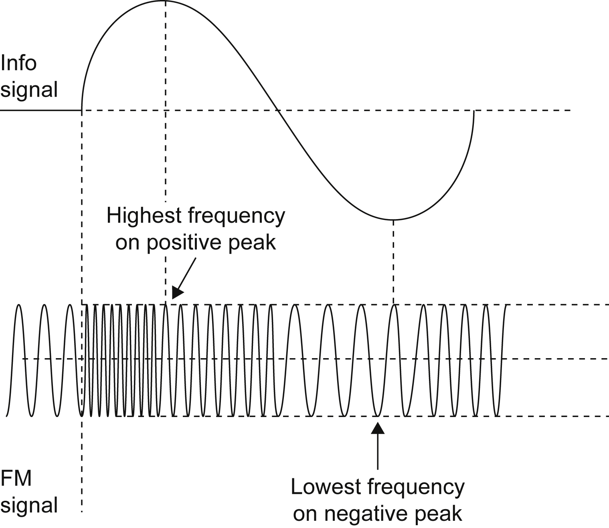
Frequency modulation
The carrier amplitude remains constant, but its frequency is changed in accordance with the modulating signal.
Specifically, the higher the amplitude of the information signal, the greater the frequency change.

Slide 30
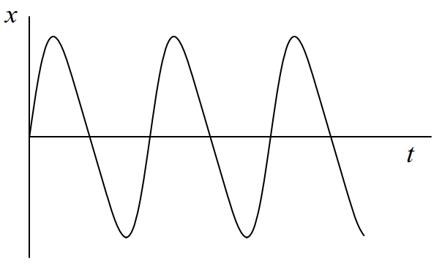
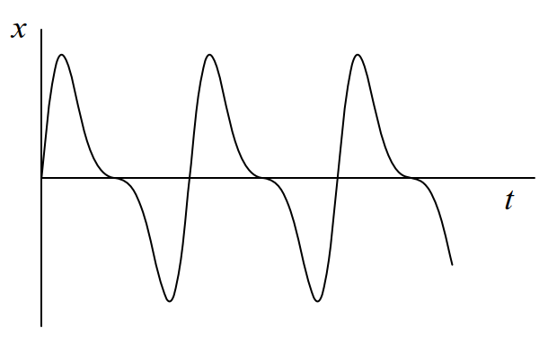
FM synthesis
The idea behind FM synthesis is similar to FM radio, but the carrier and the signal are both in the audio range, and usually related by a small rational frequency ratio.
Example, a 440 Hz carrier and 440 Hz modulator
Small values of B
Larger values of B
This gives a way of making an audio signal with a rich harmonic content relatively simply.
If we wanted to synthesize these waves using additive synthesis, it would be much harder

Slide 31
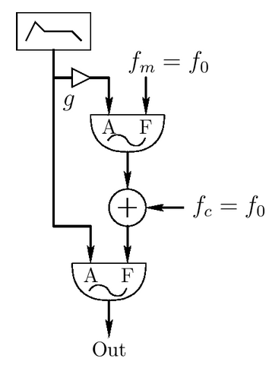
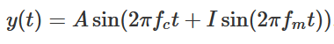
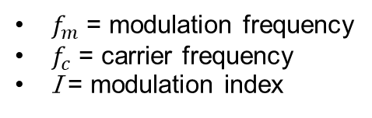
FM synthesis
$f_{m}$ = modulation frequency
$f_{c}$ = carrier frequency
I = modulation index
Two sinusoidal oscillators are used, one as the modulator and the other as the carrier.

Slide 32
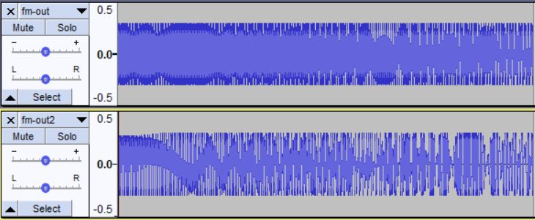
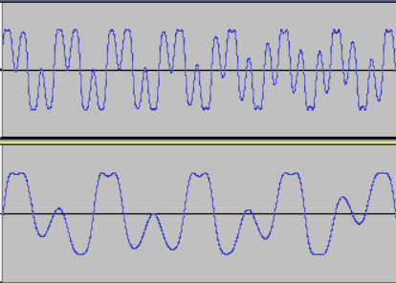
FM synthesis
Note that we modulate phase instead of frequency!
more correct name would be phase modulation (PM)
PM and FM produce essentially the same kind of sound
In analog devices, FM is used: PM is practical only digitally
The above equation does not express the relationship of the magnitude of harmonic frequencies.
sin(a + b sin(c)) can be written as a sum of weighted sinusoids using Bessel functions

Slide 33
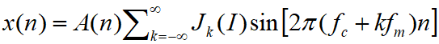
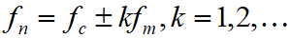
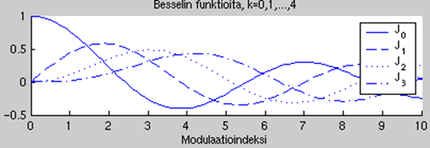
FM synthesis
For those who want more details,
not important for exam
The formula on the previous slide can be written as
where J_{k} is a Bessel function (1st kind) of order k evaluated at I.
From the above formula we can see that PM synthesis (and FM synthesis) produces frequency components
Figure: Bessel functions Jk(I) for k = 0,1,…,3

Slide 34
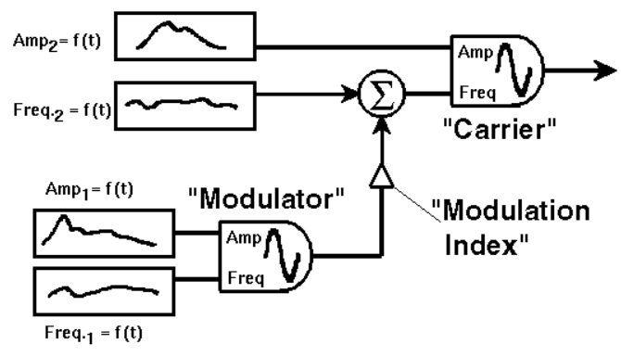
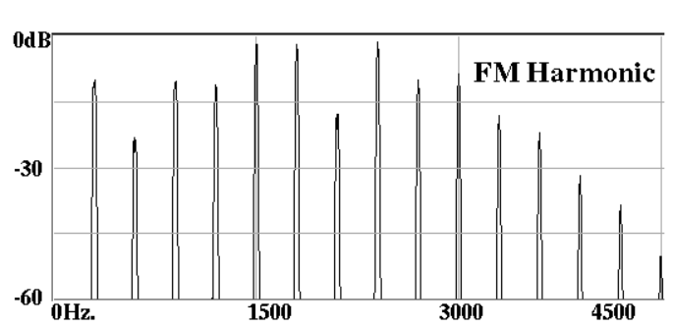
FM synthesis block diagram
Sideband sinusoidal partials appear around the Carrier frequency, spaced at integer multiples of the modulation frequency.
Harmonic related sidebands result

Slide 35
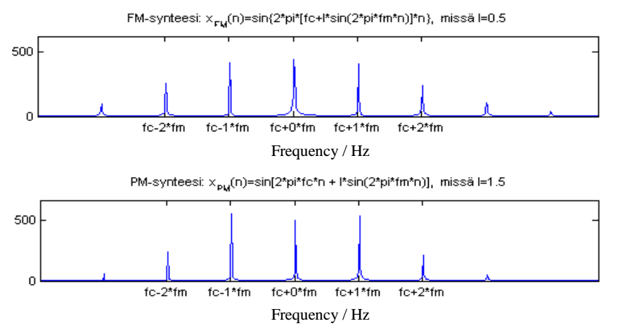
FM synthesis
Harmonic sound is obtained by setting the carrier and modulation frequencies into a whole-number ratio
FM vs PM:

Slide 36
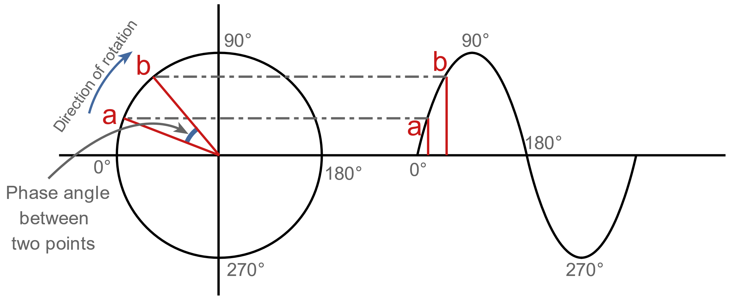
Phase modulation
Phase shift is a time shift between two sine waves of the same frequency.
The information signal can be used to shift the phase of the carrier with respect to the carrier reference.
The resulted signal looks the same as an FM signal.
PM is easier to implement (electronically) than FM.
PM and FM are types of angle modulation.
A sinusoidal waveform in the time domain and its representation in the phase domain.

Slide 37
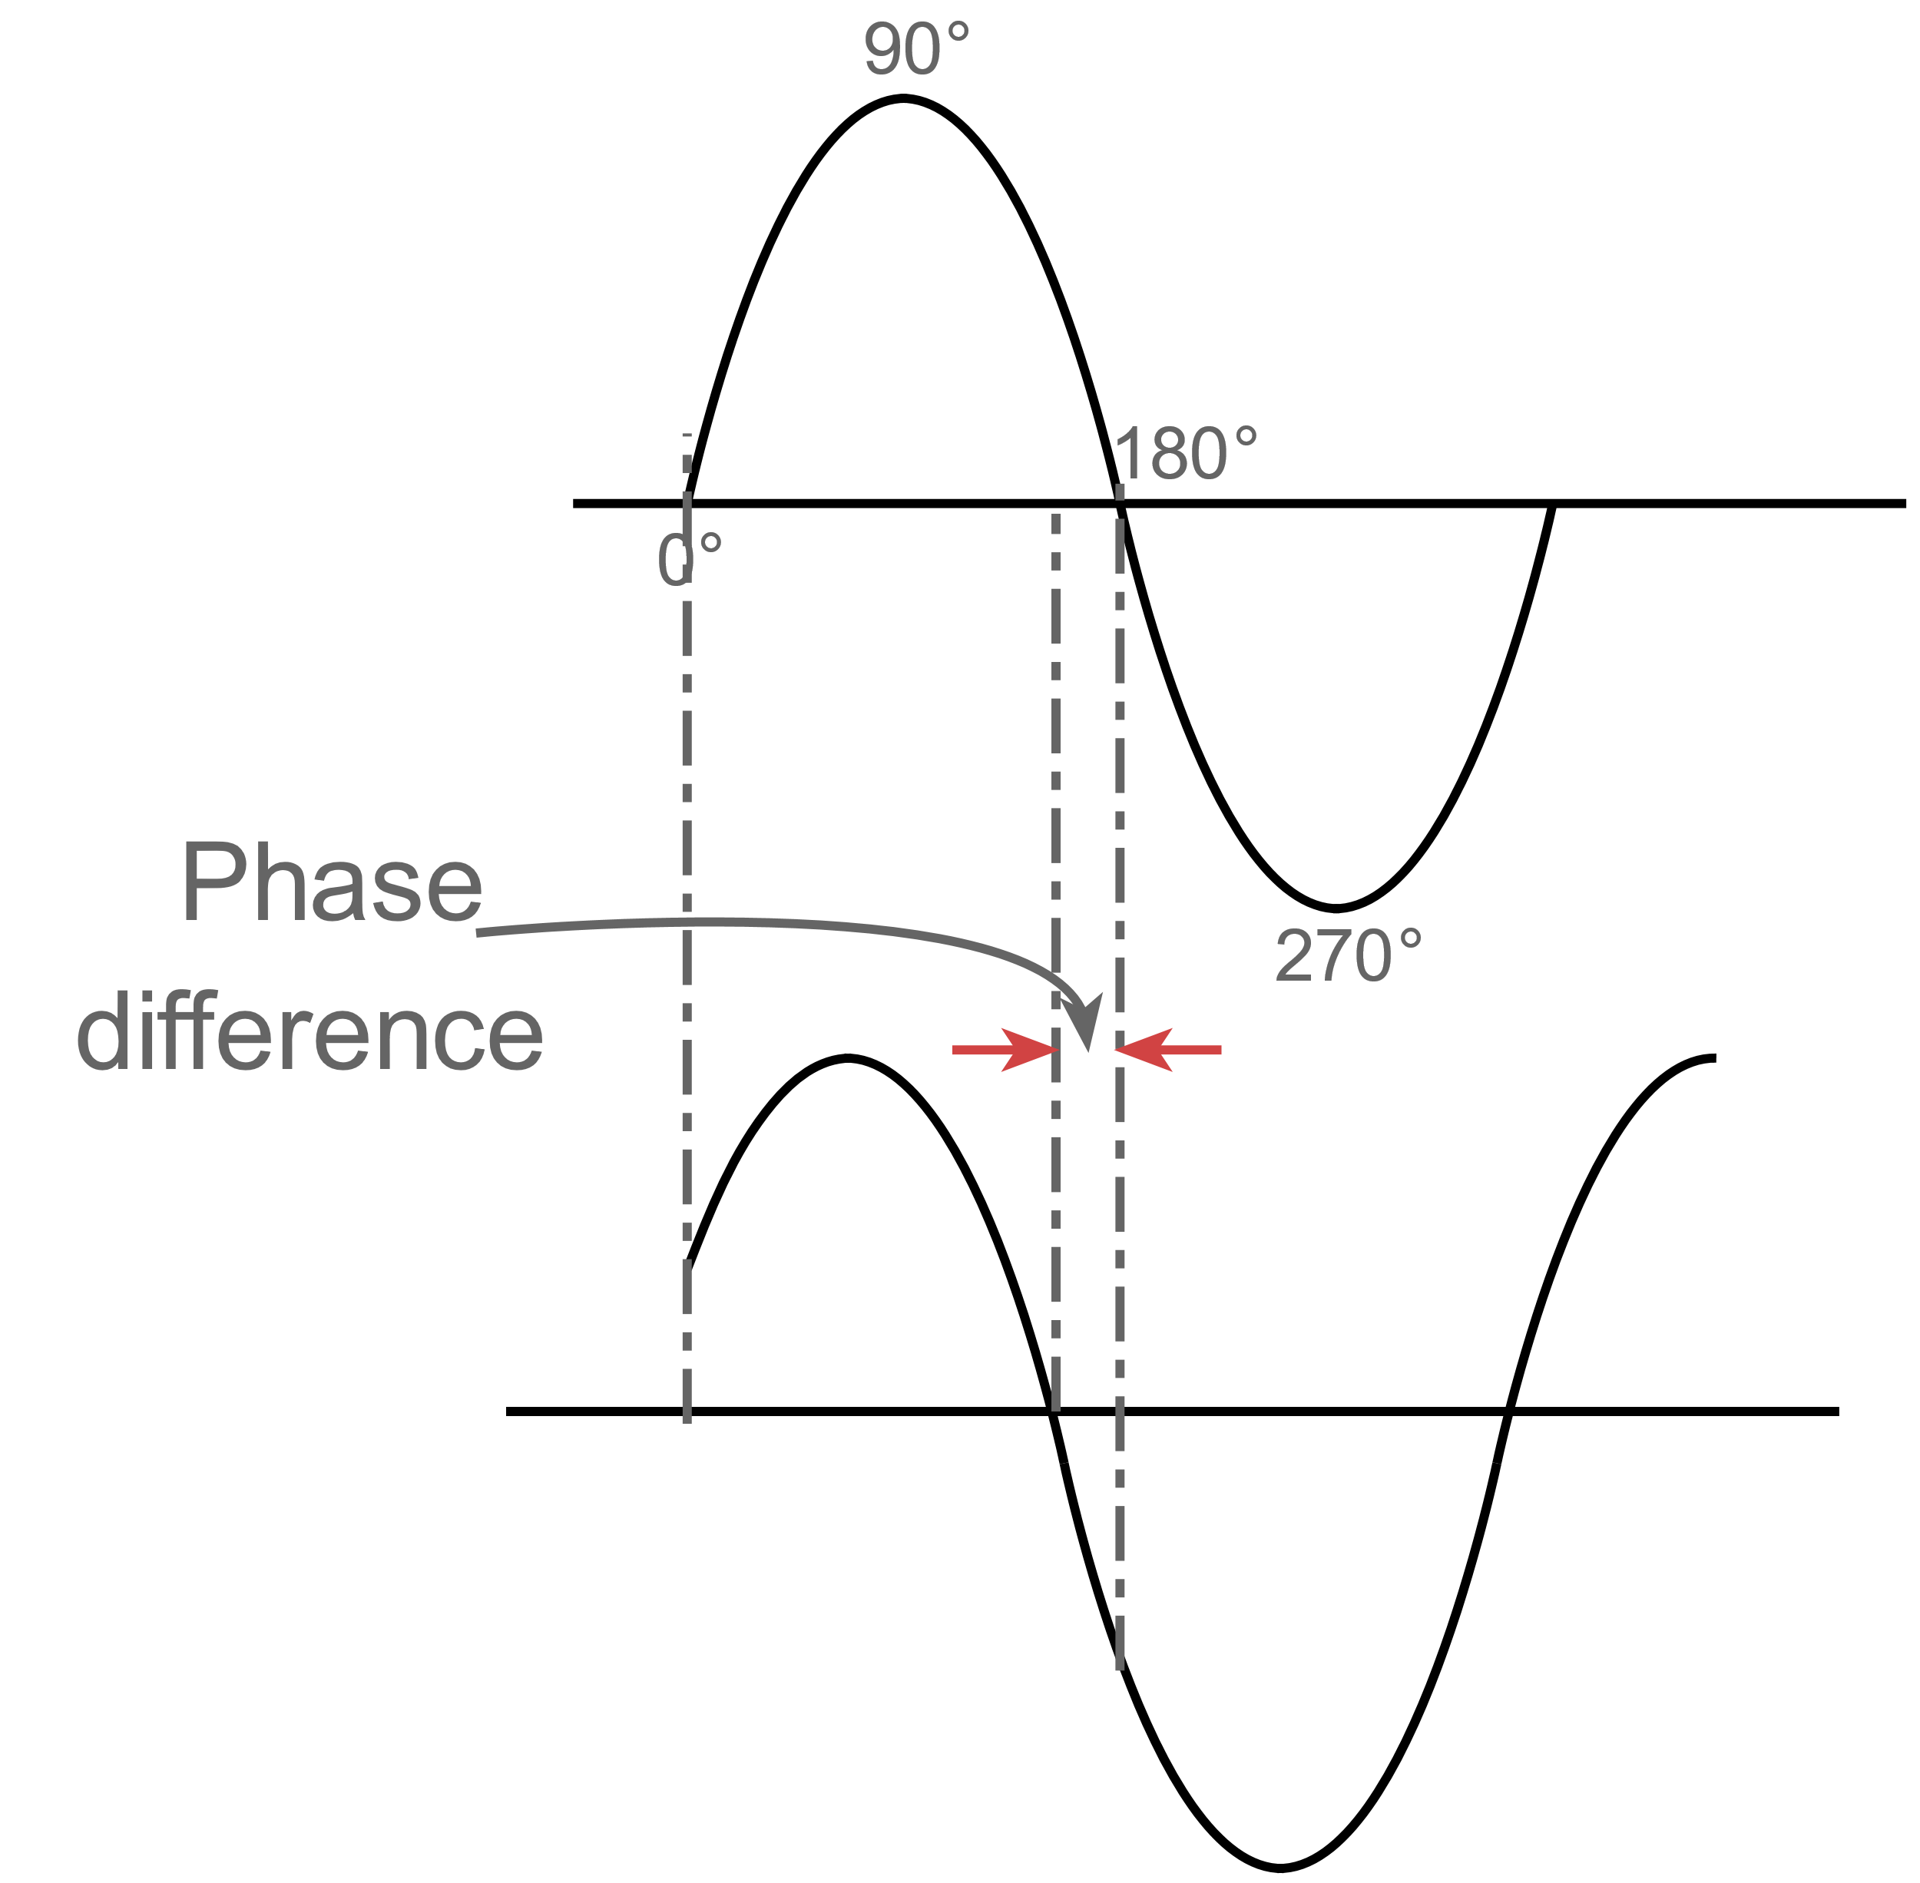
Phase
A sine can be represented by the movement of a point around a circle.
Phase is the angle between the start point and the point on the waveform at a given point.

Slide 38
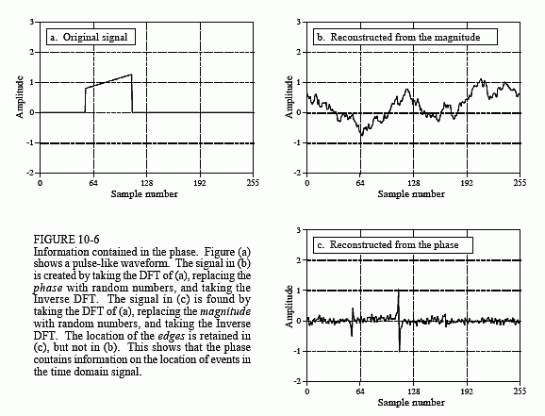
Importance of the Phase

Slide 39
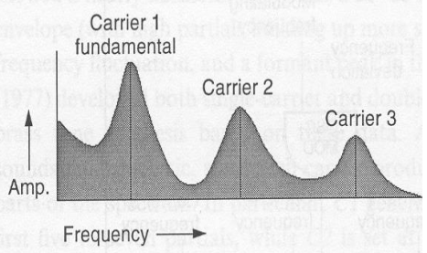
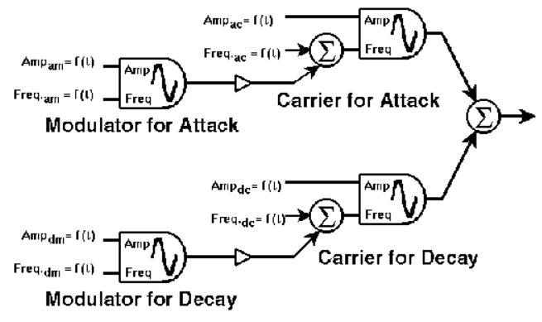
FM synthesis: extensions
Compose the desired spectrum by summing the output of several basic FM blocks
FM block diagram for Guitar
[Roads96]

Slide 40
Phase vocoder

Slide 41
Vocoder
invented in the 60s when researching speech compression methods
Vocoder (voice coder) that does analysis synthesis of human voice.
Process of analyzing and synthesizing the human voice (or another modulator signal) for audio transformation.
How it works:
Presents the signal in multiple parallel channels, each describing the signal in a particular frequency band →simplify the spectral information, reduce the amount of data needed to present the signal.
Applications nowadays: audio time stretching, pitch shifting, audio morphing, time-frequency domain processing

Slide 42
Phase vocoder
A vocoder splits the modulator signal into frequency bands, and a carrier signal is filtered according to the level of the modulator in each of these frequency bands.
Phase vocoder: also the phases are synthesized.
General name for analysis-synthesis methods where
Audio signal is represented as a sum of sinusoids
In addition to magnitudes and frequencies, also phases are synthesized
Usually implemented using short-time Fourier transform (STFT)
Spectrum modification method: allowing modifications to the amplitudes or phases of specific frequency components of the sound, before resynthesis

Slide 43
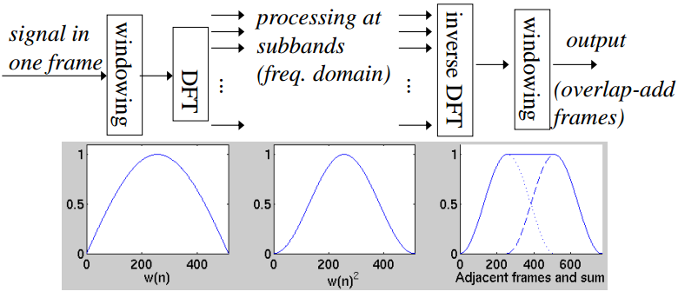
Analysis-synthesis systems
Sine window (left panel below) is useful in analysis-synthesis systems
squared sine window equals the hanning window (middle panel)
Sine windowing is done again in resynthesis to avoid artefacts at frame boundaries in the case that signal is manipulated in the f-domain
50% frame overlap leads to perfect reconstruction if nothing is done at subbands

Slide 44
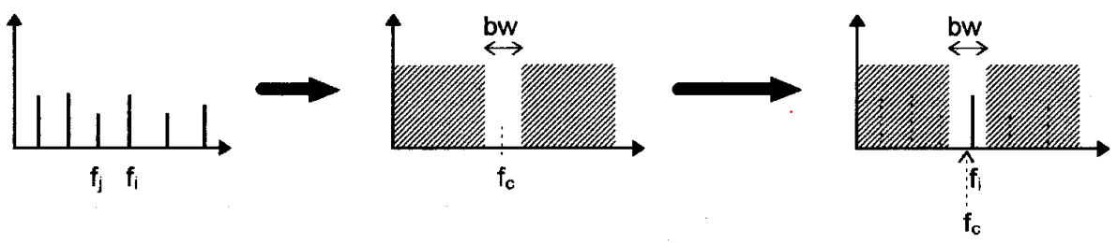
Analysis
Two issues:
Possible to detect each individual component at any given moment.
Band-pass filter, if a component of frequency f falls withing the bw, all the other components are outside, only f will go through.
The spectrum changes as time goes by.
The spectrum have to be sampled at regular intervals.

Slide 45
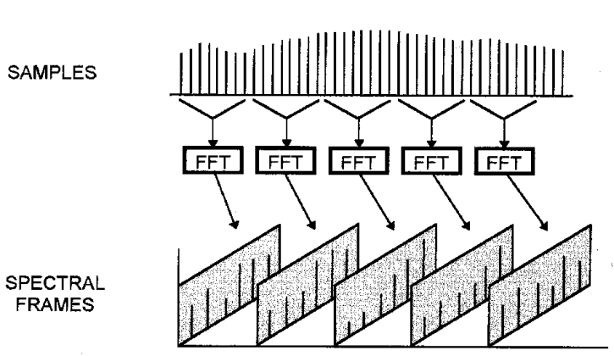
Detection of spectral changes
Sample the spectrum at appropriate intervals to follow the changes in the spectrum of a signal.
If they are taken in isolation, the samples start and end abruptly, producing “transients” in the signal (we heard them as clicks).
Alleviated by taking overlapped samples and smoothing the edges.
Overlap also increases the resolution by analysing more samples within the same temporal interval.

Slide 46
Processing stage
Set of spectral frames (output of the STFT) provides a description of the way the spectrum of a signal changes in time.
The duration of a STFT representation depends on the number of frames per seconds in the analysis.
Not altered == same duration
Manipulated == time-stretch of a sound, without changing its pitch. We can repeat each frame resulting in doubled duration.

Slide 47
Synthesis stage
IFFT, converts spectral information into samples.
Reverses the analysis stage in order to convert the spectral frames into a time-sampled signal.
Converts spectral frames into overlapped windows with samples.

Slide 48
Time stretching and pitch shifting
Phase vocoder allows audio time stretching and pitch shifting
Time stretching
Change the time interval between frames during synthesis,
OR alternatively, frames are copied or deleted at suitable intervals
time-domain windowing has to be done carefully to avoid artefacts
phases are processed to keep phase time derivative unchanged (duration • 2 phases • 2)
(more details in exercise this week)
Pitch shifting
A single recording of an instrument can be pitch shifted over a frequency range
The range producing credible results depends on the instrument
Piano: one note per octave (there are 12 notes in octave) can be sufficient
Horn, human voice: several recordings per octave are required

Slide 49
Pitch shifting
Pitch shifting
Time-stretch first, then resample the signal so that duration becomes the same again, but pitch changes
Large changes make especially speech sound strange, because the coarse spectral envelope is shifted too (formants)
Using the spectrogram representation, sound can be flexibly processed before returning to the time domain
Filtering: multiply with frequency response
Morphing sounds: interpolate the magnitude and phase spectra of sounds
Original
Low pitch
High pitch

Slide 50
Physical modeling
Musical acoustics: physics branch aimed to improve understanding of instruments
A mathematical model is developed for an instrument
Typically a set of differential equations describing components of the instrument
The motion of the real system can be modeled accurately given boundary conditions and external forces
Numerical methods are used to solve the equations by discretizing them using finite difference approximation methods.
Challenges
Computational complexity
Producing realistic sounds
Benefits:
Small memory footprint
Parametric representation allows to generate wide range of sounds

Slide 51
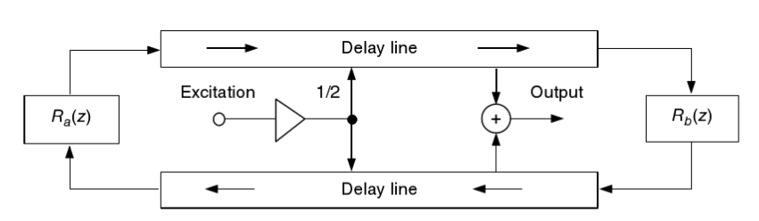
Digital waveguides
Idea: Use digital filters to model the traveling wave.
Can allow real-time synthesis (computationally efficient physical modeling), with high quality when applicable
Linear elements of one-dimensional with uniform mass distribution
E.g. vibrating strings, pipes, horns
Figure: digital waveguide to model a string of a guitar
R_{a}(z) and R_{b}(z) model attenuation of vibration at the terminals

Slide 52
Neural audio generation

Slide 53
Neural audio generation
Modern deep learning approaches present a novel and relatively unexplored way for sound synthesis
They model the probability density of actual data p_{D}(x) with a model p_{model}(x).
A joint-probability model is often applied
p_{model}(x) needs to be learned from the data
Model parameters are iteratively updated so that p_{D}(x) is modeled accurately by p_{model}(x)
Can be unconditional or conditional to external input
Conditioning information can be e.g. desired note: p_{model}(x|note)
Sampling from p_{model}(x) will produce a signal, that resembles an actual signal, sampling from p_{model}(x|note) produces a signal to model the note

Slide 54
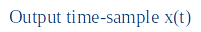
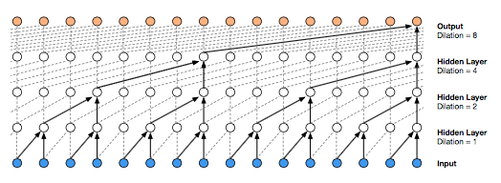
Nsynth neural audio synthesis
Uses a Wavenet as an autoencoder
Wavenet is a convolutional neural network, with dilated convolutions to increase the “receptive field” size
Can model any kind of audio

Slide 55
Wavenet
An autoregressive model (think of an IIR filter)
Structure:
Contains 30 convolutional layers with dilation: 1,2,4,…,512,1,2,3,…,512,1,2,4,…512
Efficient way to model that the current output sample depends on thousands of past samples
Uses skip-connections and gated activation units
Output value is a class from 1,…,256, where each class represents a u-law compressed sample value
u-law is non-linear quantization that applies logarithm for amplitude.
Training:
Learn to predict next sample given past samples
Update model parameters based on the prediction error
Testing
Predict sample x_{t} using T past predicted samples.
Place predicted sample to place, predict x_{t+1} using past T-1 samples
Notes:
Original wavenet parameters are not described in the arxiv publication
However, reproduction attempts exist

Slide 56
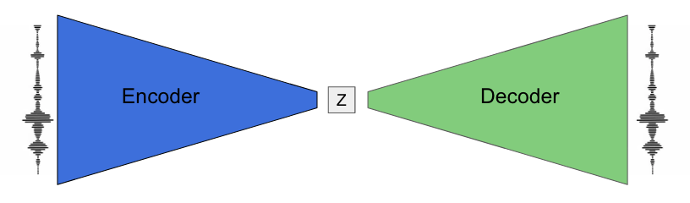
Autoencoder
Artificial neural networks with an encoder and a decoder stage
Encoder represents the input with less dimensions
Forces a compressed view / representation of the input ( Z-space in figure)
Decoder produces the output from the compressed representation
Output = Input

Slide 57
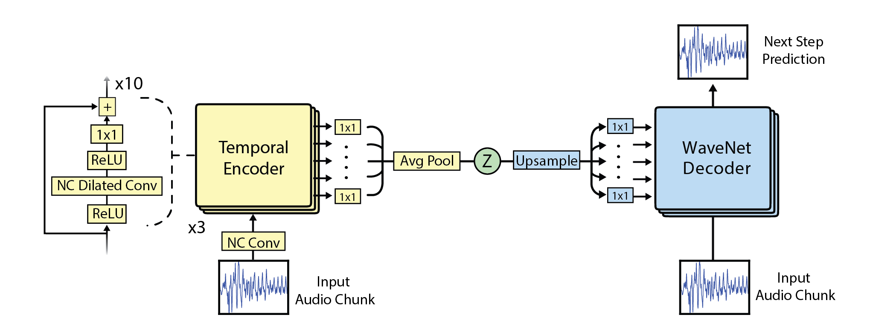
NSynth
Temporal encoder: reduces data to Z-space (embedding)
Wavenet decoder: reconstructs the signal using also the interpolated Z-space representation
The decoder is conditioned on the Z-space embedding

Slide 58
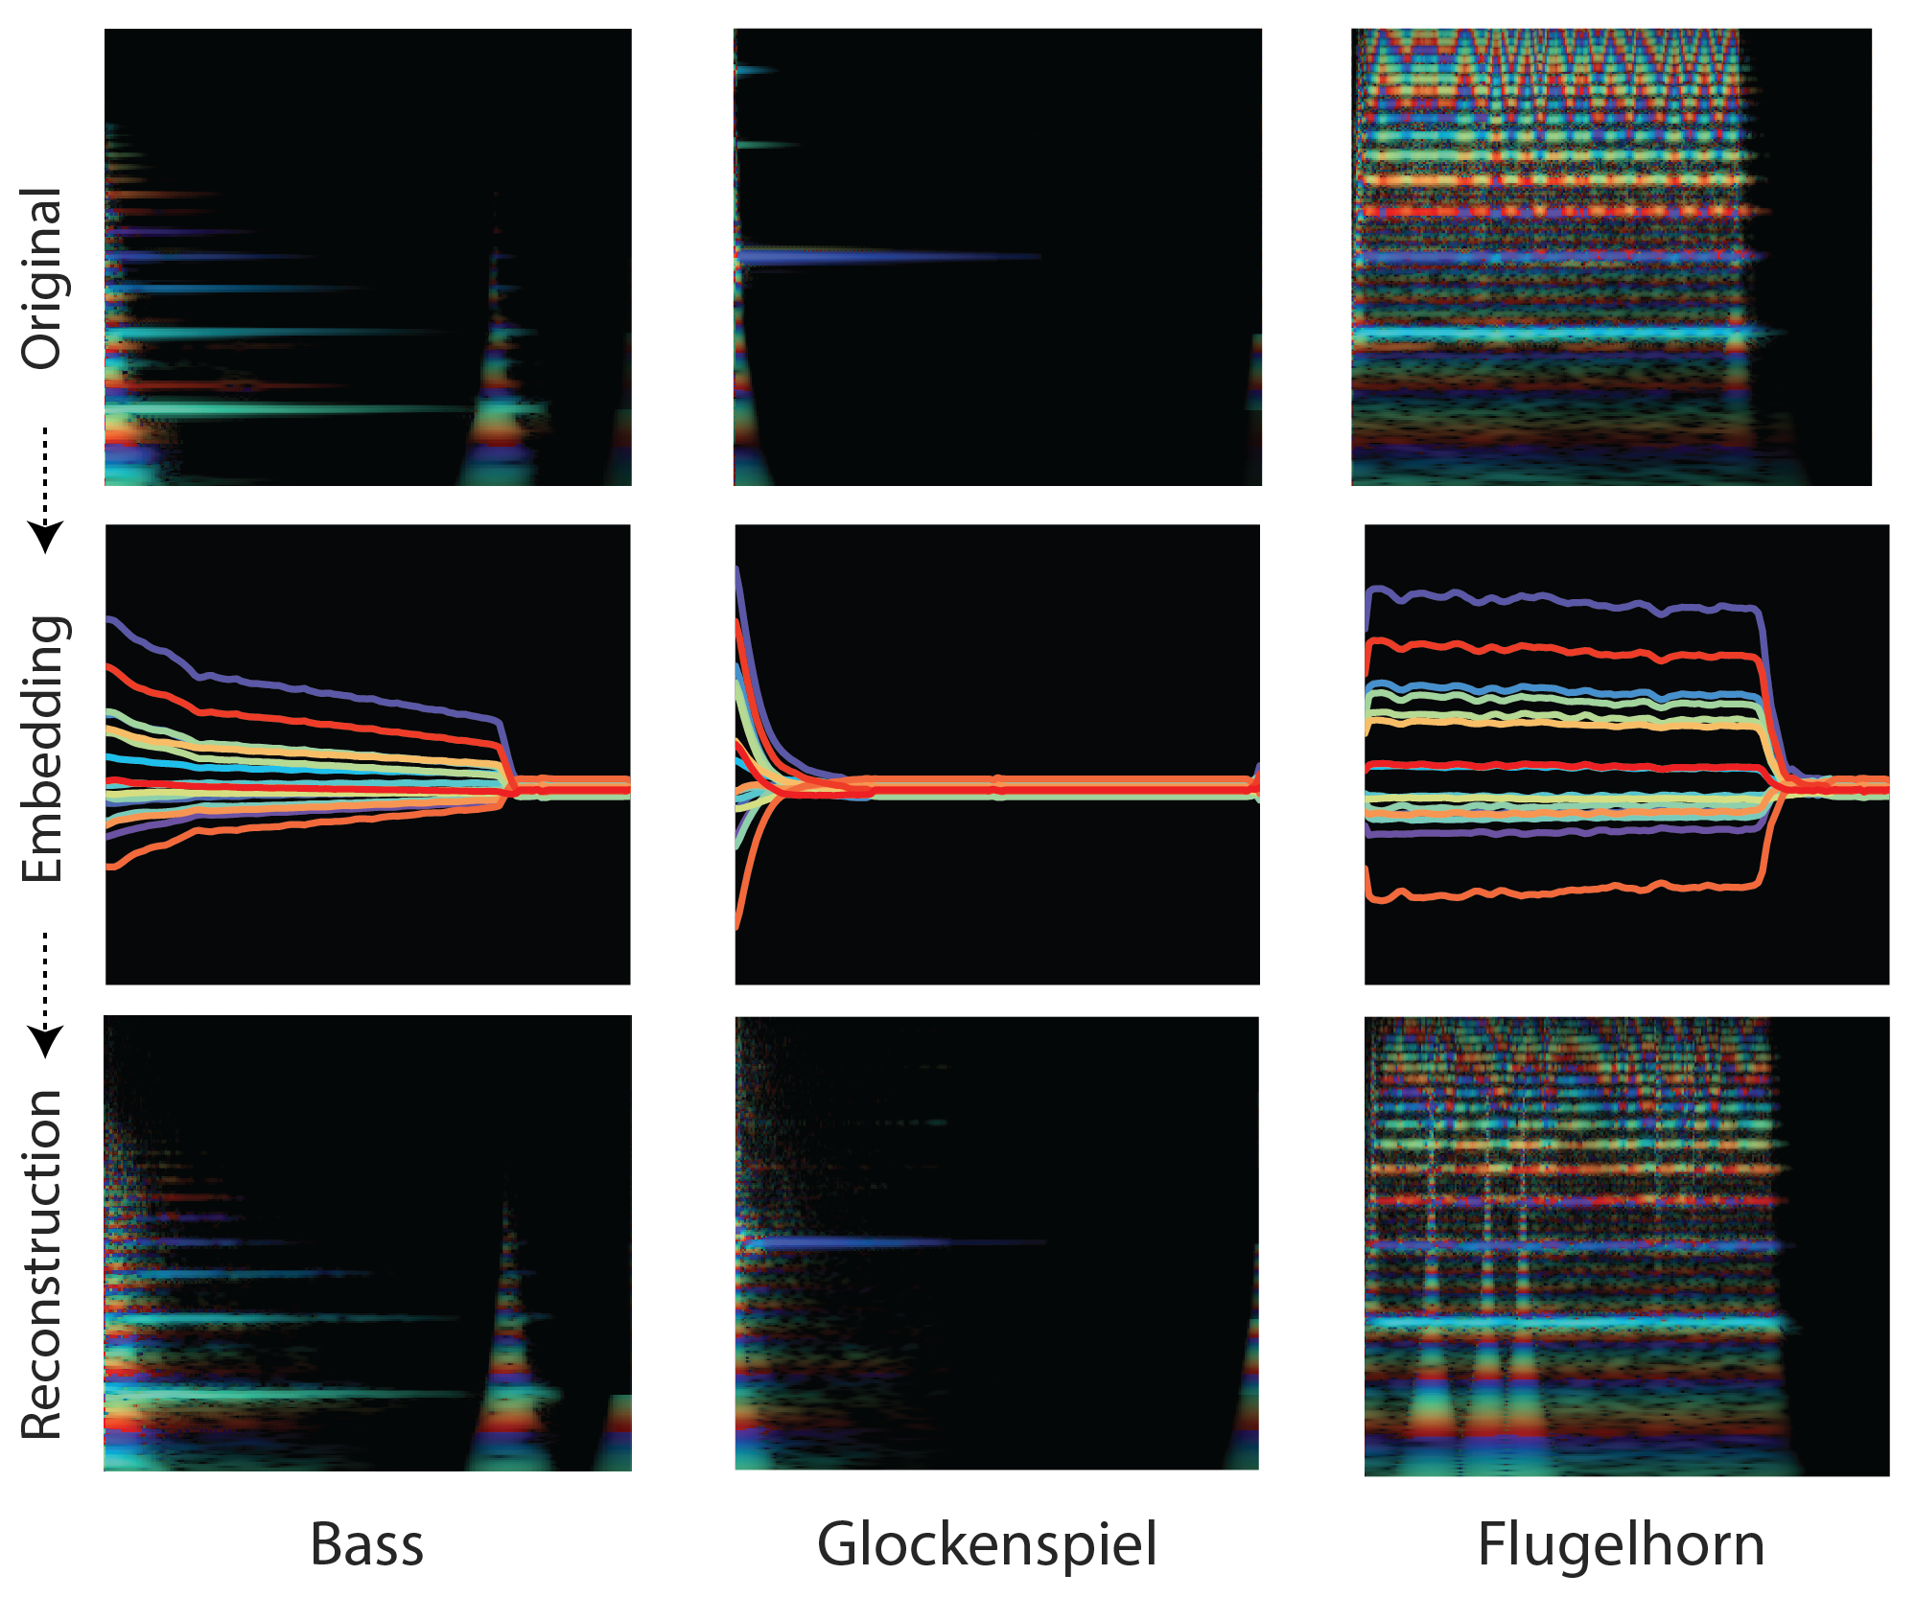
Reconstructed samples
Read more at: https://magenta.tensorflow.org/nsynth

Slide 59
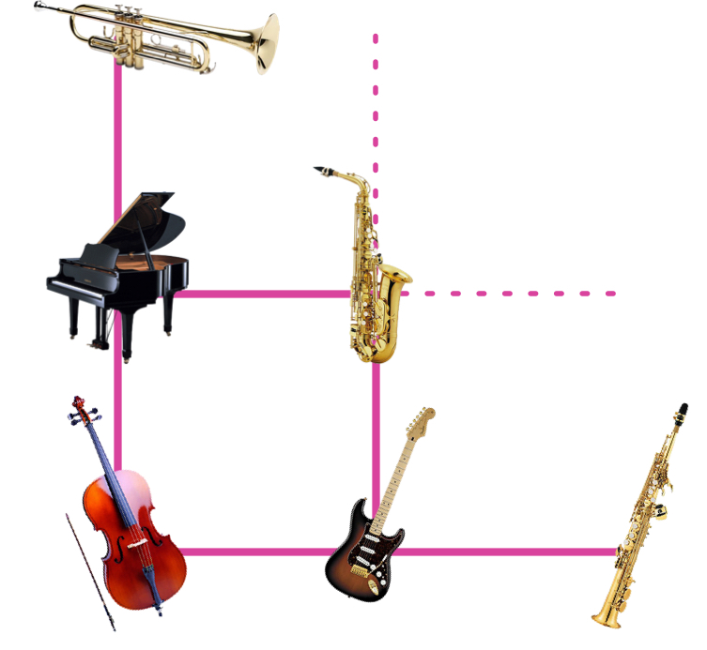
NSynth
Z-space embedding allows
New hybrid instruments: mixing the encoded signals of two separate sounds
Time stretching
Demos:
https://www.youtube.com/watch?v=rU2ieu5o5DQ
https://experiments.withgoogle.com/ai/sound-maker/view/
Model training
305979 musical notes, 1006 instruments
“The WaveNet model takes around 10 days on 32 K40 gpus…”.
Synthesis
Pre-trained models are available for synthesis [2]
https://github.com/tensorflow/magenta-demos/tree/master/jupyter-notebooks
Samples: time stretching
Original
Fast
Slow

Slide 60
Summary
Different approaches for sound synthesis:
Additive synthesis, FM synthesis
Sampling synthesis
Physical modeling
Neural modeling
Challenges and benefits of each approach

Slide 61
Extra material
Sound wave visualized
https://www.youtube.com/watch?v=XBP0jmpjzBw
John M. Chowning. 1977 paper
https://www.jstor.org/stable/23320142#metadata_info_tab_contents

